Slide 1
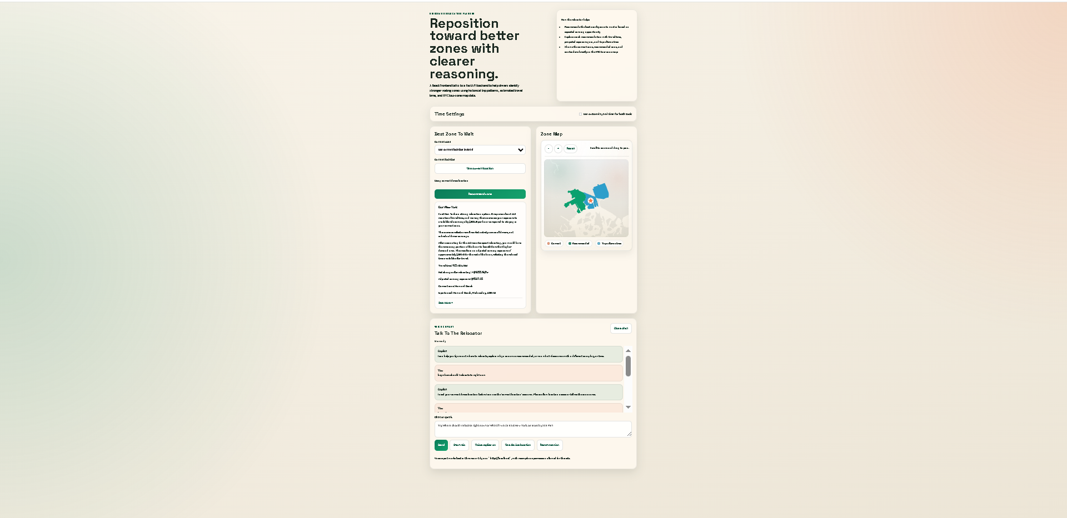
DRIVER EARNINGS
NAVIGATOR
Machine Learning Relocation Recommendations for NYC Uber Drivers
A full-stack app that ranks nearby TLC zones using historical Uber trip patterns, estimated travel time, and adjusted earning exposure.
3.19M
0.9749
148.6 ms
Training rows
Avg NDCG
API response
Live app demo: planner + map + copilot
Capstone Presentation – Bodrul Jalal
Notes:
Opening: Driver Earnings Navigator is my capstone app for helping NYC Uber drivers decide where to wait next. It is not claiming to guarantee individual driver pay; it estimates historical market earning exposure and ranks relocation zones.

Slide 2
PROBLEM AND SOLUTION
The decision problem
Drivers need fast, practical relocation guidance between trips.
Problem
Solution
Research Question
• Demand changes by zone, day, and hour. • Moving zones costs time that could otherwise be spent waiting for requests. • Newer drivers may not know TLC zone patterns. • During slow periods, waiting in the wrong zone can waste a large part of a shift.
• Rank nearby candidate zones instead of giving raw data. • Account for travel time before recommending relocation. • Explain the recommendation in plain language. • Show current, recommended, and alternative zones on a map.
How can a machine-learning-powered web app help NYC Uber drivers reduce unproductive waiting time by recommending nearby NYC TLC zones using historical Uber trip patterns, estimated travel time, and adjusted earning exposure?
Outcome: a ranked relocation recommendation, not a guaranteed personal earnings prediction.
Notes:
Explain that the app targets the moment after a ride ends or during a slow period. The driver wants to know whether staying put or moving to another nearby zone has stronger historical earning exposure after travel time.

Slide 3
USERS
Who the app is built for
Two driver personas shaped the interface and feature priorities.
Full-time NYC driver
Part-time or newer driver
• Long shifts with changing demand patterns • Needs quick decisions during slow periods • Wants an explanation before spending time relocating
• Less intuition about TLC taxi zones • Needs map context and simple guidance • Benefits from natural-language what-if scenarios
User journey
Open app safely between rides
Select zone or use device location
Optional day/hour scenario
Receive ranked recommendation
Check map + explanation
Decide to stay or relocate
Notes:
This slide shows why the user experience favors fast recommendations, short explanations, and map context instead of raw analytics.

Slide 4
APP DEMO
Application overview
Planner, map, recommendation text, alternatives, and copilot are part of one decision-support workflow.
Key capabilities
• Current zone dropdown or device location • Custom day/hour what-if scenarios • Recommended zone with travel-time tradeoff • Top alternatives for comparison • Taxi-zone map highlights • Chat/voice copilot explanations
Notes:
Use the screenshot to show the app is implemented, not only conceptual. Emphasize that the app exposes model output in a driver-friendly way.

Slide 5
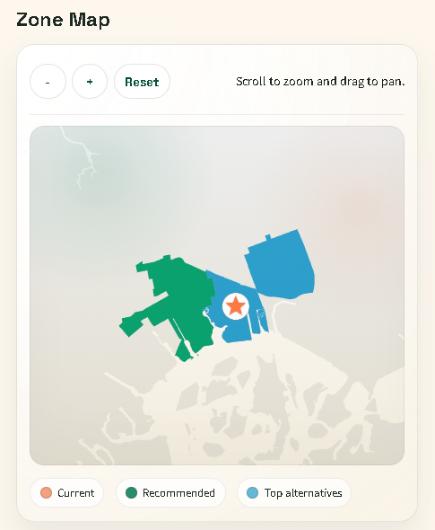
APP DEMO
Actual zone-map render
The map gives spatial context for current, recommended, and alternative TLC taxi zones.
Why the map matters
• TLC zone names do not always tell drivers where the area is geographically. • Color coding separates current zone, recommendation, and alternatives. • Drivers can compare zones before spending time relocating. • Future map improvements can add streets and landmarks.
Map legend behavior
Current zone
Recommended zone
Top alternatives

Slide 6
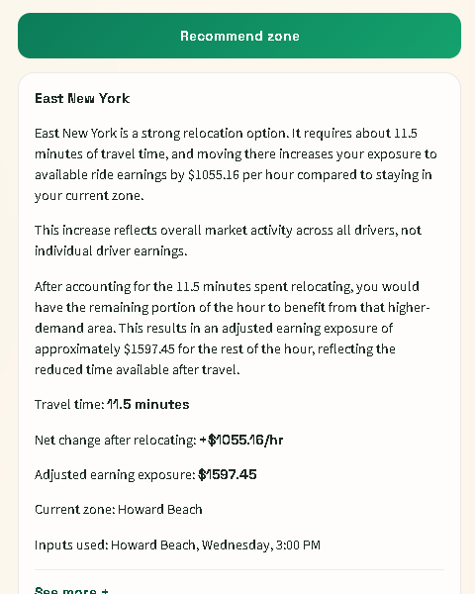
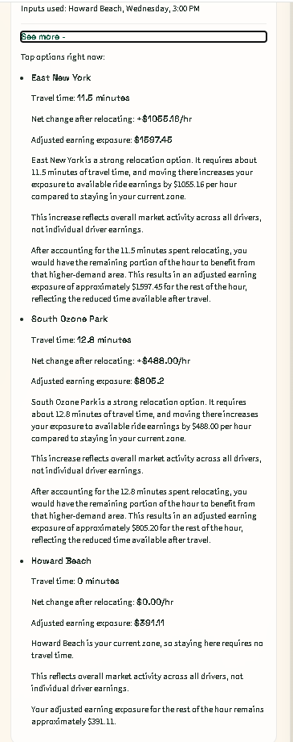
APP DEMO
Howard Beach recommendation example
This example ranks East New York first, then South Ozone Park, then staying in Howard Beach.
Ranking output
1
East New York
11.5 min • +$1055.16/hr
2
South Ozone Park
12.8 min • +$488.00/hr
3
Howard Beach
0.0 min • $0.00/hr
The stay-put option is included so the model can recommend not relocating when moving is not worth it.
Notes:
This slide addresses the corrected example: for Howard Beach, East New York is the top recommendation, South Ozone Park is second, and Howard Beach itself is the stay-put baseline.

Slide 7
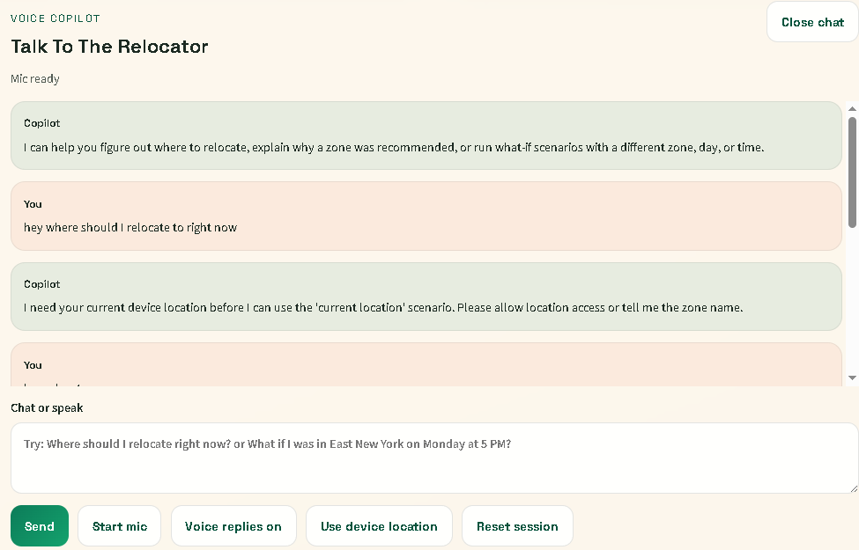
COPILOT
Voice/text copilot
The copilot reduces reading load and supports natural-language what-if scenarios.
What it adds
• Driver can ask “where should I relocate right now?” • Supports what-if questions by zone, day, and time. • Explains model recommendations in plain language. • Works as a convenience layer over the recommendation service.
Design reason
User feedback suggested that some drivers would rather ask questions naturally than read every field manually.

Slide 8
ARCHITECTURE
End-to-end website flow and model pipeline
Solid arrows = implemented app path. Dashed arrows = planned future data extensions.
1. Offline data + model build
2. Live website recommendation path
NYC TLC HVFHV data
Uber-only cleaning
Zone/time features
Step 3 training table
Driver
React + Vite frontend
FastAPI backend
Recommendation service
Recommendation + map output
LightGBM training
Serialized model artifact (.pkl)
Loaded model artifact
Gemini API chat + voice
3. Future data extensions
Why this structure?
• React keeps the driver interface fast and interactive.
• FastAPI exposes clean endpoints for recommendations, zones, GeoJSON, and copilot requests.
• The recommendation service separates ranking logic from the UI.
• The LightGBM model is saved as a reusable artifact, so it can be loaded, versioned, or replaced.
• Future signals can be added to the feature pipeline without rebuilding the entire website.
Weather
Traffic
Events + holidays
Airport signals
Future feature store / aggregate refresh
These are not implemented yet. They show how the current artifact-based system can grow into a richer production pipeline.
Notes:
Spend time on the reason for each layer. React gives the interactive interface; FastAPI exposes clean ML endpoints; the recommendation service encapsulates ranking logic; LightGBM is serialized as an artifact and can be versioned.

Slide 9
ARCHITECTURE
Why these frameworks and tools?
Each tool was selected to support fast iteration, model serving, and a demo-ready user interface.
React + Vite
FastAPI
Fast interactive UI, component-based screens, quick local builds, and simple deployment path for a web demo.
Python-native backend, strong fit for ML serving, automatic API structure, and low-latency JSON endpoints.
LightGBM
GeoJSON + zone lookup
Efficient gradient boosting for millions of tabular rows with nonlinear zone/time interactions.
Lets the app show real TLC taxi-zone geography instead of only text recommendations.
Gemini API
PostgreSQL/RDS future path
Adds natural-language and voice support without replacing the deterministic recommendation endpoint.
Production version can store refreshed aggregates, model registry data, and monthly source lineage.

Slide 10
DATA PIPELINE
Data pipeline and feature construction
Historical trips are transformed into zone/time and route/time features used for ranking.
Raw TLC
HVFHV files
Uber-only
cleaning
Processed
trip facts
Zone-hour
earnings
Route-hour
travel time
Relocation
training table
LightGBM
model
Core engineered tables
Why aggregate first?
• Zone/day/hour earning opportunity metrics • Route/day/hour average travel-time metrics • Candidate relocation rows with current zone, destination zone, hour, day, and travel time
• Recommendations should not scan raw trip rows at runtime. • Aggregates make model input and explanation fields fast to look up. • The same design maps cleanly to future PostgreSQL/RDS tables.
Notes:
Explain the difference between raw data and serving data. The model should not compute all historical averages on each API call; it should load precomputed artifacts or query aggregate tables.

Slide 11
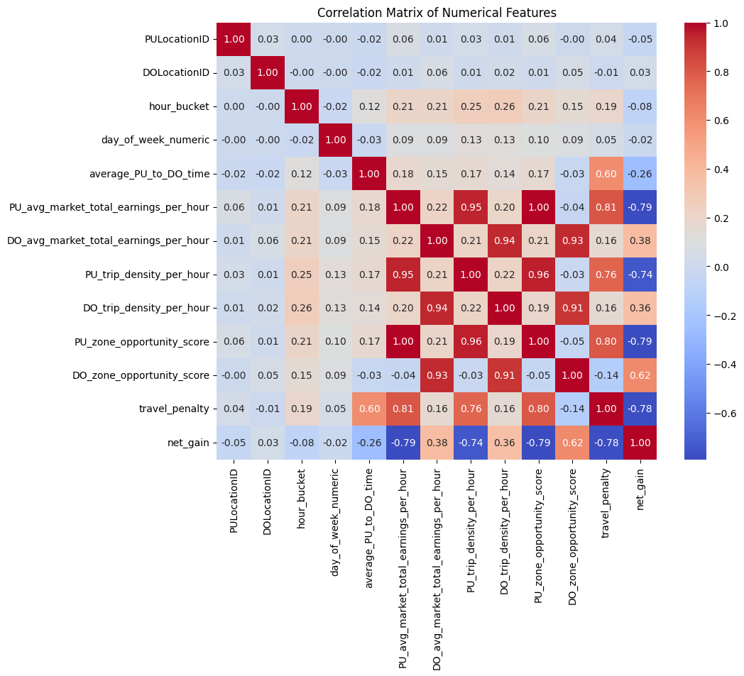
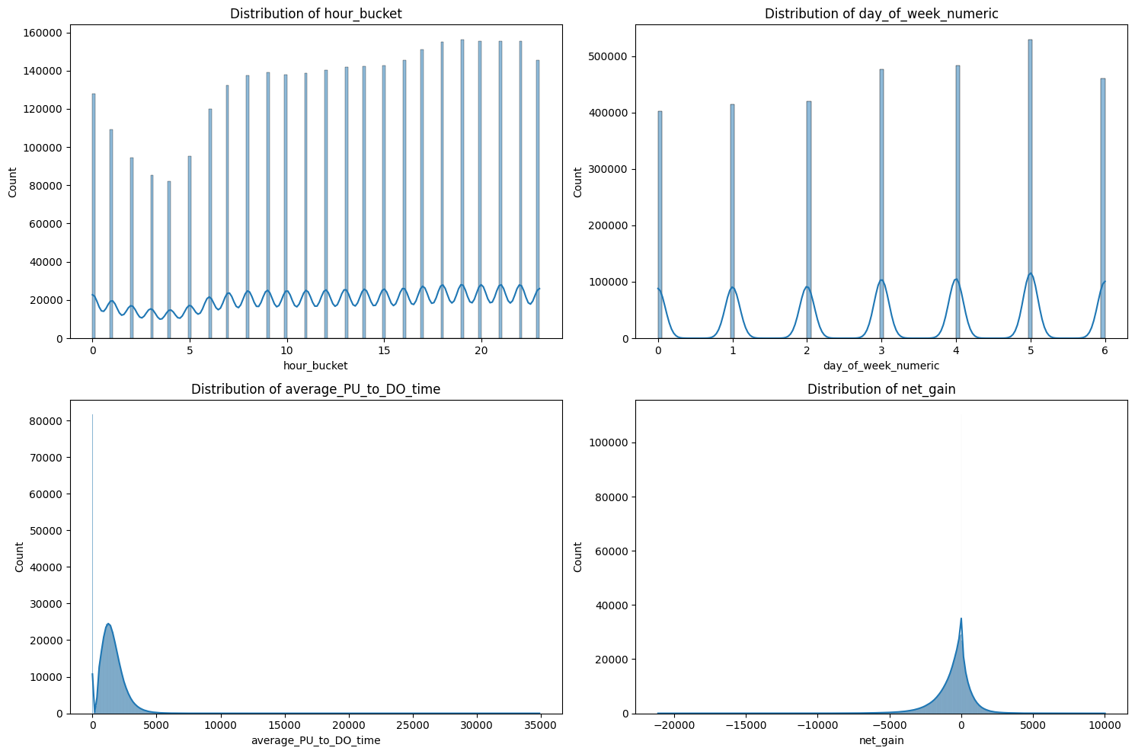
DATA EXPLORATION
Exploratory data analysis
EDA verified feature distributions and helped identify relationships before modeling.
EDA confirmed the training table includes time patterns, travel-time variation, and strong relationships among earning, density, opportunity score, travel penalty, and net_gain.

Slide 12
MODEL
Model formulation: recommendation as regression ranking
The app needs a ranked list of candidate zones, not just a yes/no relocation label.
Input context
Model output
Why regression?
• Current zone • Candidate destination zone • Hour of day • Day of week • Average travel time
predicted_net_gain
• A binary classifier would only say relocate or not. • A numeric score allows many zones to be compared and sorted. • The backend can include stay-put as a candidate. • The user receives top alternatives, not a single blind answer.
A continuous score representing the historical relocation benefit after accounting for travel-time cost.
Higher score = stronger relocation candidate

Slide 13
MODEL
Why LightGBM Regressor was selected
LightGBM matches the project’s data shape: large, tabular, nonlinear, and ranking-oriented.
Compared with simpler models
Why gradient-boosted trees
Why LightGBM specifically
• Linear regression is easier to explain but too limited for zone × hour × day interactions. • Rule-based scoring is transparent but cannot learn complex patterns from millions of rows. • Deep learning is more complex than necessary for this structured tabular data.
• Decision trees split data into regions such as zone/time/travel-time combinations. • Boosting adds trees sequentially, where each tree corrects errors left by earlier trees. • This captures nonlinear patterns without manually coding every interaction.
• Fast training on millions of rows • Efficient prediction for API serving • Handles categorical-like numeric zone IDs through learned splits • Provides feature importance for explanation and debugging

Slide 14
MODEL
How a tree model outputs a continuous value
A regression tree does not vote for a class; each leaf stores a numeric prediction.
Is current zone
near high-opportunity
areas?
Gradient boosting prediction
Each tree outputs a number. LightGBM combines many trees by adding their outputs together.
Hour is
slow period?
Travel time
small enough?
ŷ = initial average + tree₁(x) + tree₂(x) + ... + treeₙ(x)
Because the leaf values are numeric, the final prediction is continuous. That is how a tree-based model can predict a dollar-like net_gain score rather than only a category.
Leaf value
+240
Leaf value
-120
Leaf value
+880
In this app, the continuous score is used to rank zones.
Notes:
This slide is useful for explaining why regression trees are compatible with continuous output. A classification tree stores class probabilities in the leaves. A regression tree stores averages or fitted numeric values. Gradient boosting adds many small numeric corrections together.

Slide 15
MODEL
How LightGBM handles nonlinear relationships
The value of a relocation zone can depend on combinations of current zone, candidate zone, day, hour, and travel time.
Nonlinear example
Why this matters for rideshare
A 12-minute relocation may be worth it at 3 PM from one zone, but not worth it at 11 PM from another zone.
• Demand is spatial: some zones are stronger than others. • Demand is temporal: patterns change by hour and day. • Travel time is a cost: longer repositioning reduces remaining opportunity. • The recommendation must combine these factors rather than treating them independently.
• Trees split the feature space into many rule-like regions. • Boosting combines many trees, allowing curved and interaction-heavy decision surfaces. • The model can learn that the same travel time has different meaning depending on origin, destination, and hour.

Slide 16
MODEL
Target variable and loss function
The model learns to predict net_gain and is penalized more for large numeric mistakes.
Target construction
Squared-error style regression loss
net_gain = destination earning exposure − current-zone earning exposure − travel penalty
Loss = average((actual net_gain − predicted net_gain)²)
• Positive net_gain means the candidate zone historically looked stronger after relocation cost. • Negative net_gain means travel time or weaker destination opportunity made the move less attractive. • This target supports ranking because each candidate receives a numeric score.
• Small errors receive small penalties. • Large errors receive much larger penalties. • This is useful because sending a driver toward a very weak zone is more harmful than a small ordering mistake. • RMSE is aligned with this squared-error training objective.
Notes:
This slide explains the training signal. The exact LightGBM regression objective uses a squared-error style loss by default. Since relocation scores are continuous, the model learns to minimize numeric error while the app later uses scores for ranking.

Slide 17
MODEL
Hyperparameter tuning with Optuna
Optuna searched LightGBM settings and selected the configuration with the lowest validation RMSE.
What was tuned
Why tuning matters
n_estimators
700
• Too few trees can underfit and miss demand patterns. • Too many or too-deep trees can overfit historical noise. • Learning rate controls how aggressively each tree updates the model. • Sampling and regularization reduce overfitting. • RMSE was minimized because large score errors are risky for recommendations.
learning_rate
0.0383
num_leaves
70
max_depth
11
min_child_samples
40
subsample
0.8
colsample_bytree
0.9
reg_alpha
0.0519
reg_lambda
0.00543
Tuning objective: minimize RMSE

Slide 18
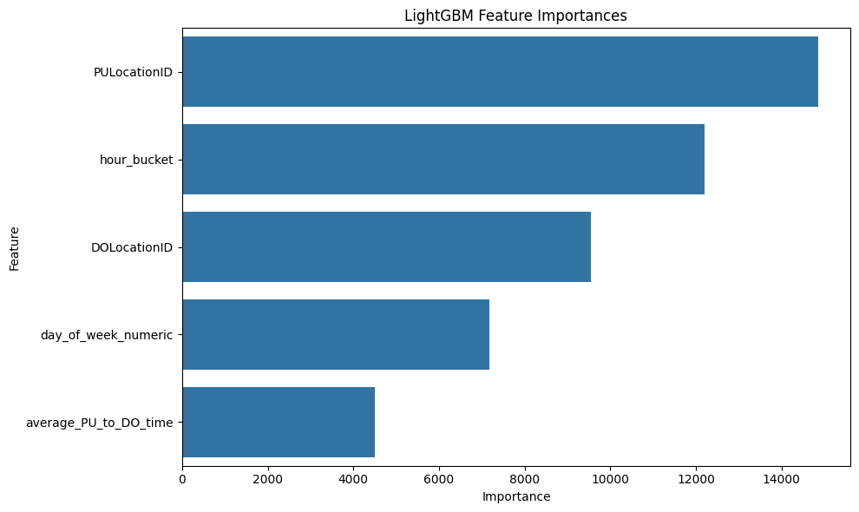
MODEL RESULTS
Feature importance
The model relied most on current zone, hour, candidate zone, day, and travel time.
Interpretation
• PULocationID is strongest because the current zone determines the starting opportunity and candidate set. • hour_bucket is important because rideshare opportunity varies heavily by time of day. • DOLocationID matters because the destination zone defines the relocation opportunity. • average_PU_to_DO_time matters because longer travel reduces the remaining usable hour.

Slide 19
EVALUATION
Model performance: what the numbers mean
The metrics evaluate both numeric prediction error and recommendation ranking quality.
MAE
317.4087
Average absolute size of prediction error in net_gain units. Lower is better.
RMSE
460.4430
Penalizes large mistakes more than MAE. Useful because very wrong relocation scores are costly.
R²
0.8854
Share of target variation explained by the model. Indicates strong fit to historical net_gain patterns.
NDCG
0.9749
Ranking metric showing whether the strongest relocation candidates appear near the top. Crucial for recommender behavior.
Why both error and ranking metrics? The app shows a ranked list of zones. Numeric error matters, but ordering better zones above weaker zones is directly tied to user experience.
Notes:
Important distinction: MAE/RMSE/R2 evaluate regression accuracy. NDCG evaluates whether the ranked list is good. Since the final product is a recommendation app, NDCG is arguably the most directly product-aligned metric.

Slide 20
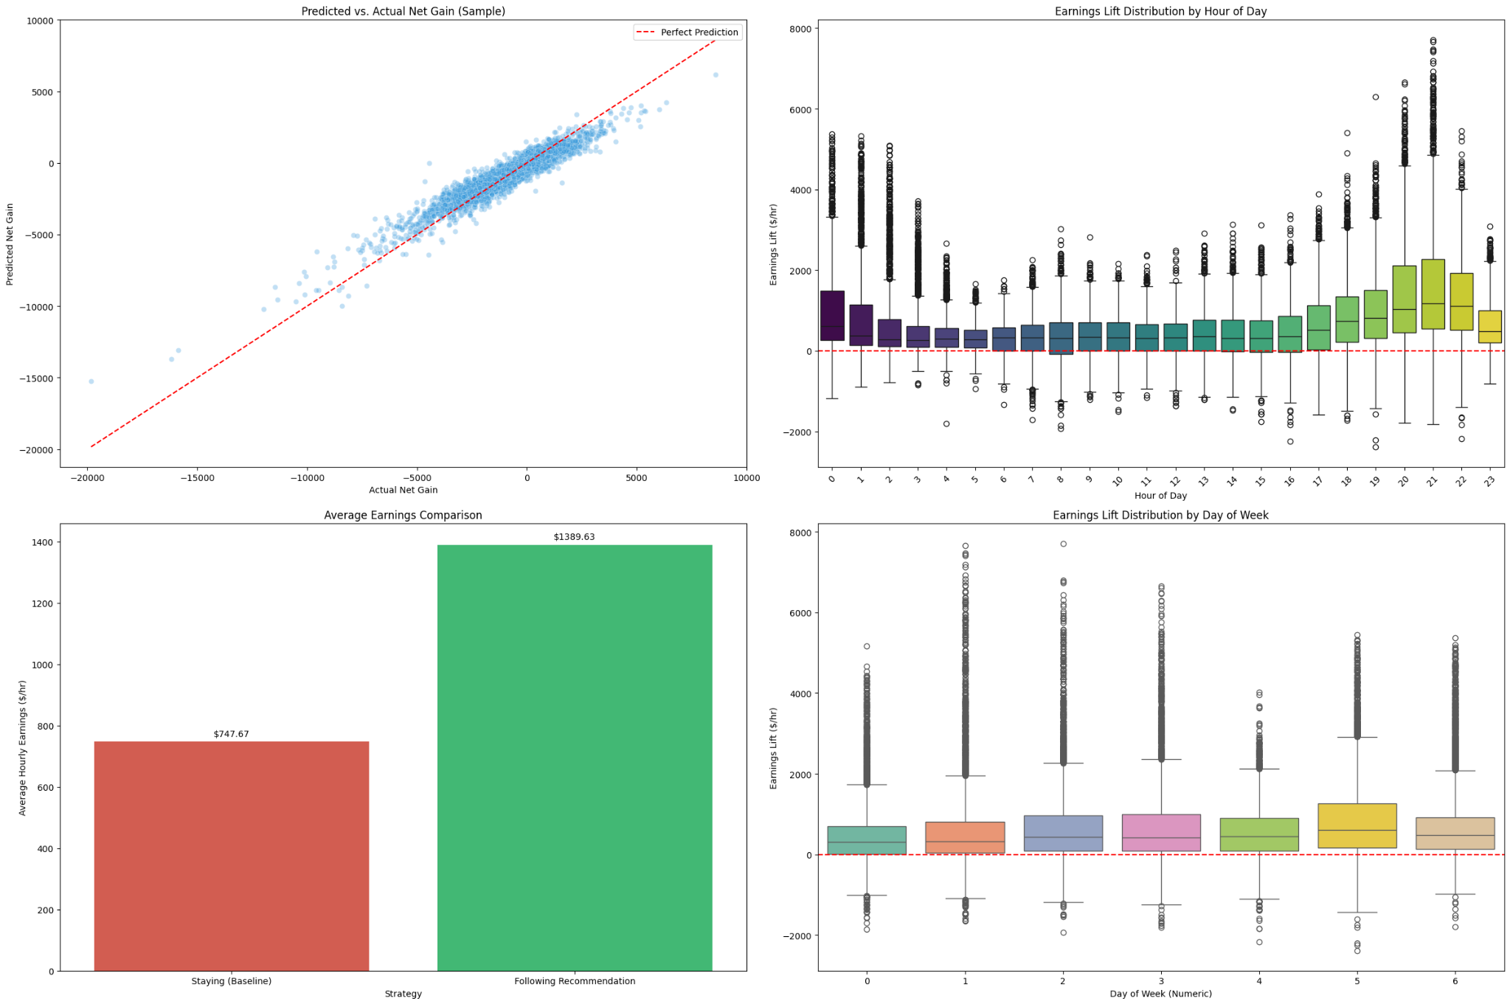
EVALUATION
Model evaluation dashboard
The notebook evaluated prediction fit and historical recommendation impact across time patterns.
Dashboard views
• Predicted vs. actual net_gain checks whether predictions follow actual values. • Earnings lift by hour checks when recommendations show more benefit. • Average staying vs. following recommendation gives a high-level impact comparison. • Day-of-week distribution checks whether lift patterns are consistent across days.

Slide 21
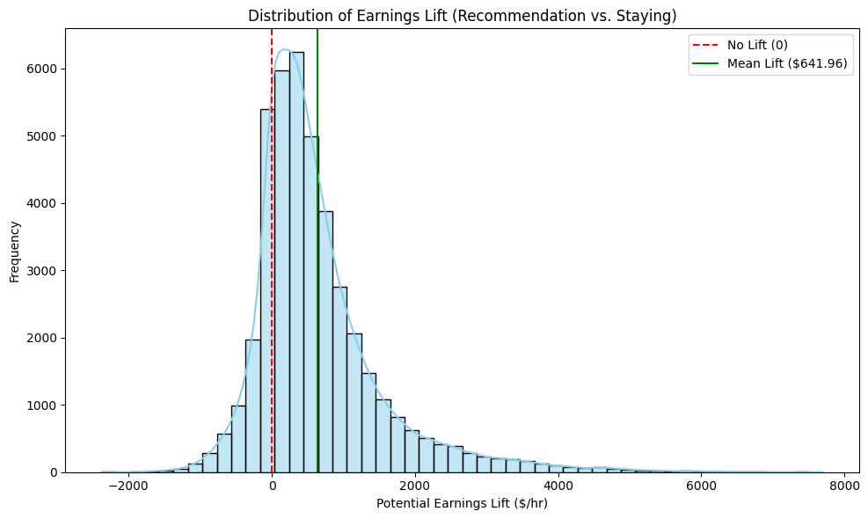
EVALUATION
Historical recommendation impact
The notebook compared staying put against following the model recommendation where a stay-put baseline existed.
Simulation results
42,367
$747.67/hr
Simulated contexts
Stay-put exposure
$1,389.63/hr
+$641.96/hr
Recommendation exposure
Mean lift
Interpretation
The model often found zones with stronger historical market earning exposure than staying put. This is not guaranteed individual driver pay; it is a historical market-opportunity signal.

Slide 22
APP ANALYSIS
Technical testing and user feedback
Testing confirmed the app flow worked locally and user feedback changed the final product scope.
Manual technical testing
User-driven iterations
• Backend health endpoint returned status OK. • Zone dropdown populated with TLC zone names and IDs. • Recommendation endpoint returned ranked result in 148.6 ms locally. • GeoJSON map rendered 263 taxi-zone features. • Copilot worked when Gemini API key/quota was valid. • Errors were shown in the UI instead of failing silently.
• Removed offered-trip prediction because a part-time driver was concerned about rejecting rides affecting ratings/perks. • Kept explanation text because a full-time driver found the recommendation aligned with local driving intuition. • Added chat/voice copilot because users wanted a lower-reading interaction style. • Kept manual zone selection because browser geolocation can be imperfect.

Slide 23
FUTURE WORK
Limitations and next steps
The current app is a strong prototype; production improvements would add live context and repeatable data refresh.
Current limitations
Next production improvements
• Historical patterns do not guarantee future individual earnings. • No live weather, events, traffic, holidays, or driver supply signals yet. • Some zone/time combinations may have limited data. • Device location depends on browser permission and accuracy.
• Monthly data refresh and rolling averages • PostgreSQL/RDS tables for aggregates and model registry • Weather, event, airport, and holiday features • Street/landmark map layer for better driver recognition • Live driver testing to measure wait-time reduction

Slide 24
Driver Earnings Navigator
Smart relocation. Better reasoning. Clearer driver decisions.
Project takeaway
This capstone combines machine learning, geospatial visualization, backend model serving, frontend UX, and conversational AI into a practical decision-support app for NYC Uber drivers.
Historical market exposure, not guaranteed individual earnings.

